Slide 1
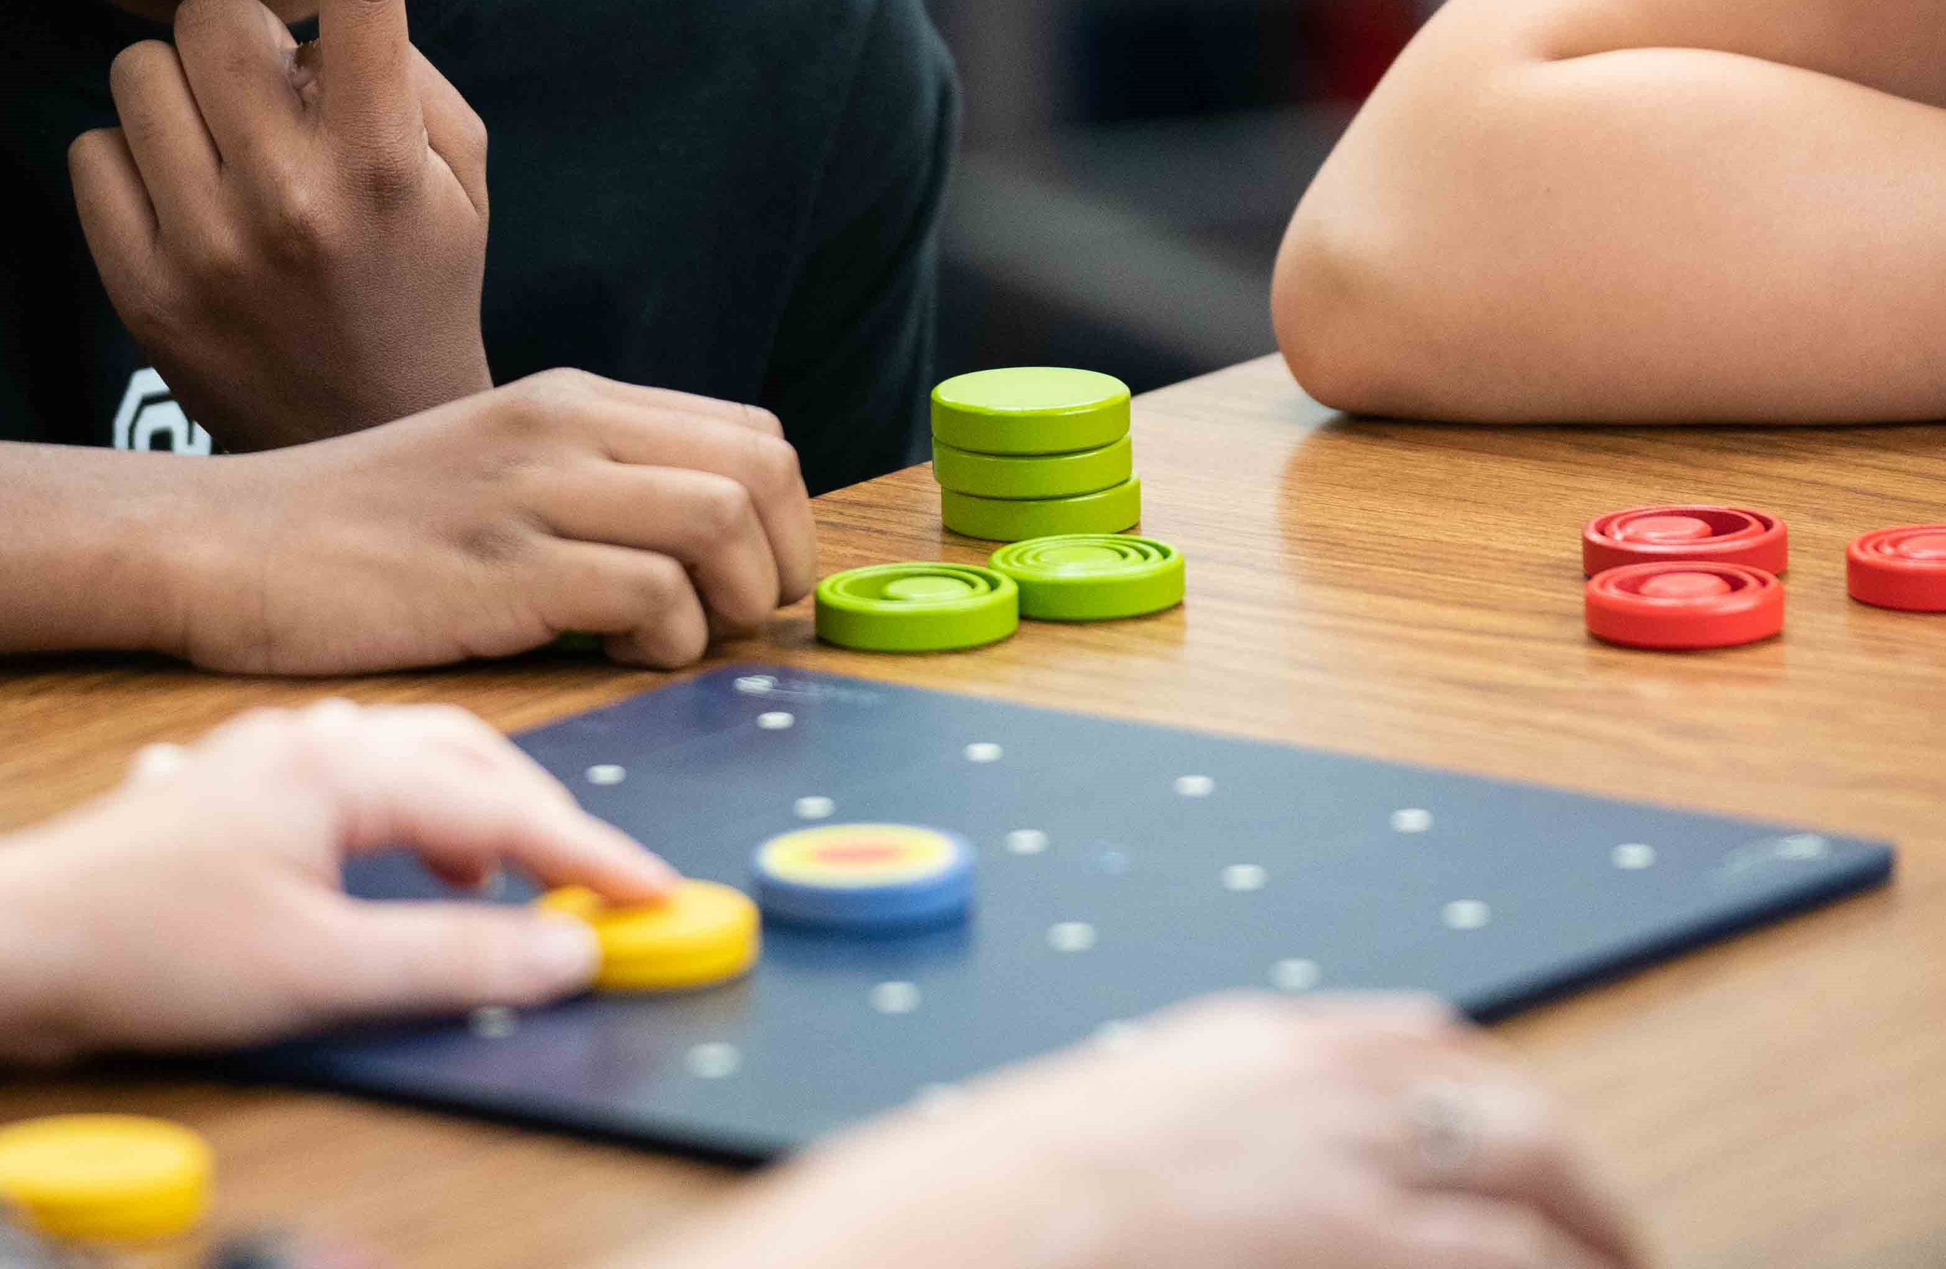
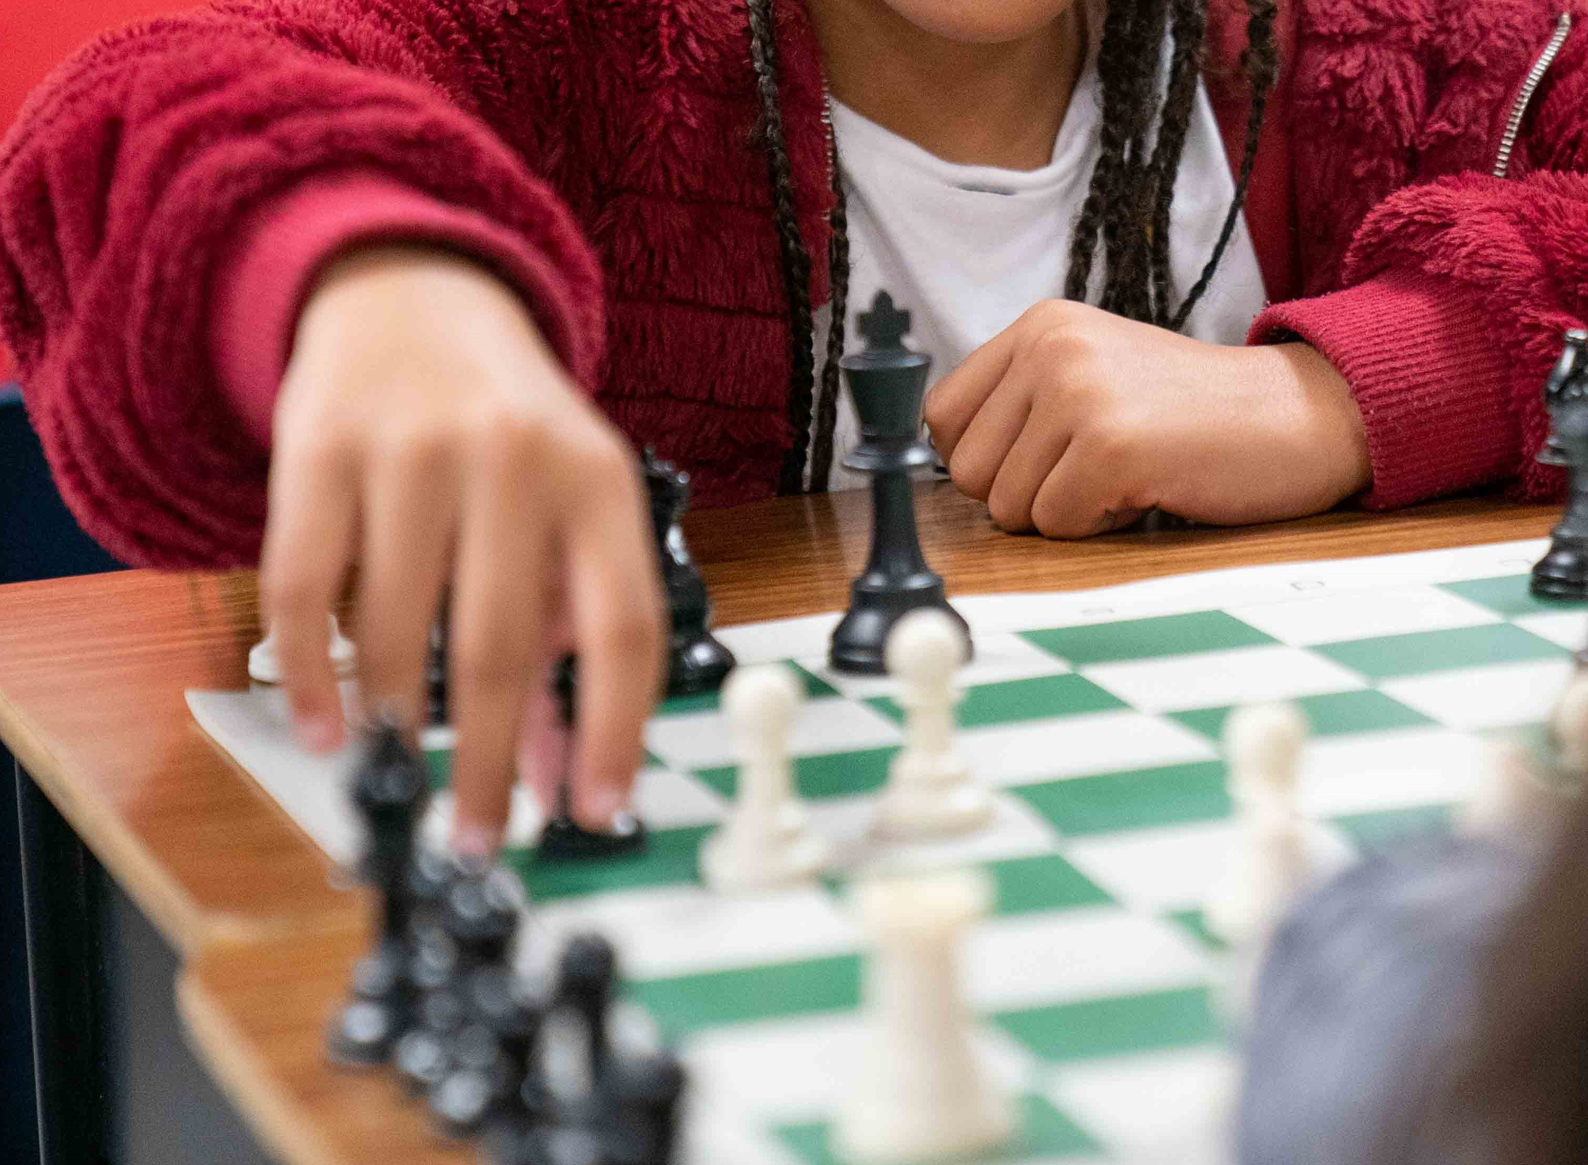
2023 WJUSD GATE Presents Family Math Nights ~Math Around the World~
Wednesday, March 15th
5:30 - 7:00 pm Douglass Middle School Gym OR Wednesday, March 22nd 5:30 – 7:00 pm Lee Middle School Gym REGISTRATION REQUIRED! Sign Up Here! https://forms.gle/TLyvtxomnSSeTvrTA
Solve mathematical puzzles!
Fun for families and friends!
Learn strategy games
For more information, email deann.tenhunfeld@wjusd.org

